Slide 1
Sieve of Eratosthenes
By Shivansh

Slide 2
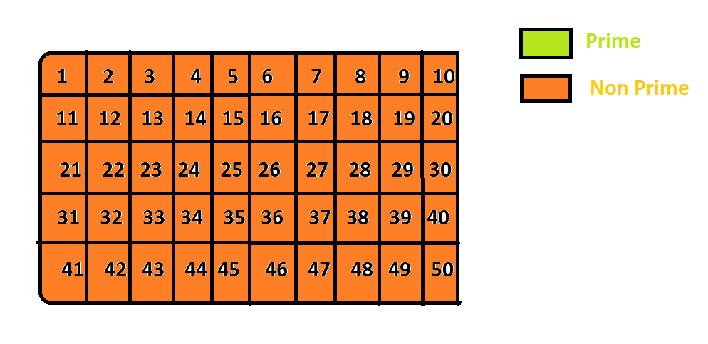
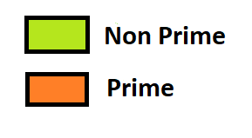
Step1- All primes

Slide 3
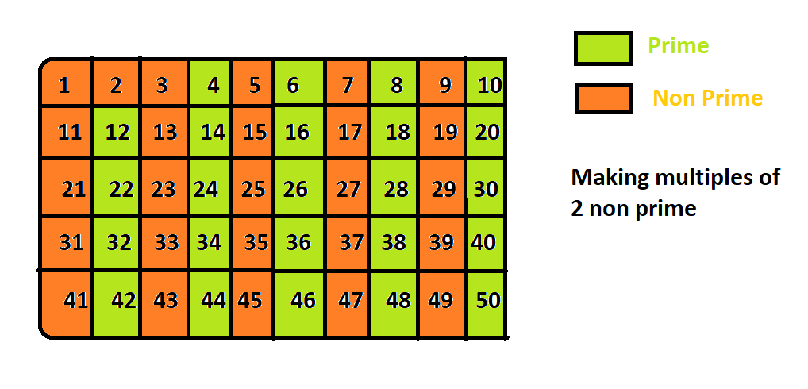
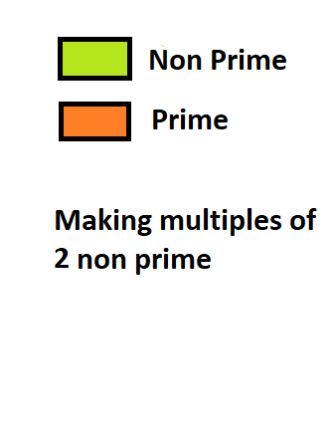
Step 2- Make multiple of primes nonprime from 2

Slide 4
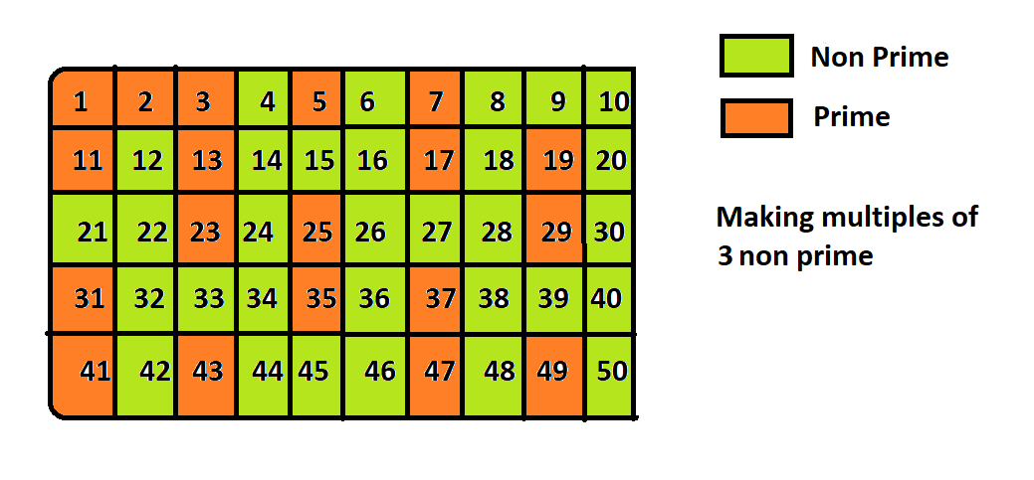
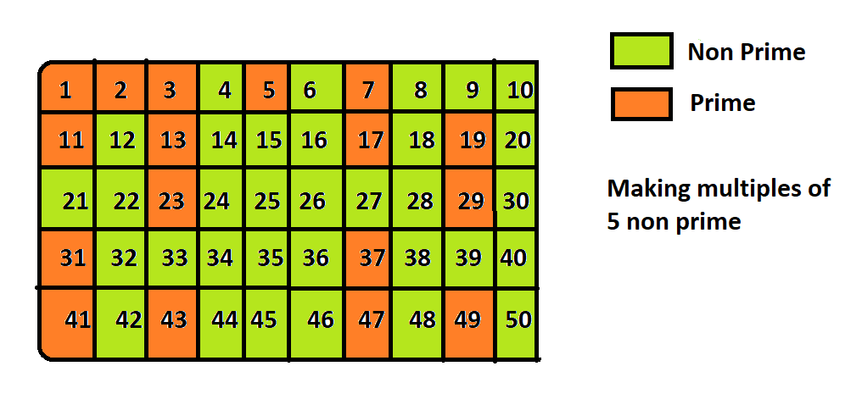
Step 2(b)...same for 3, 5

Slide 5
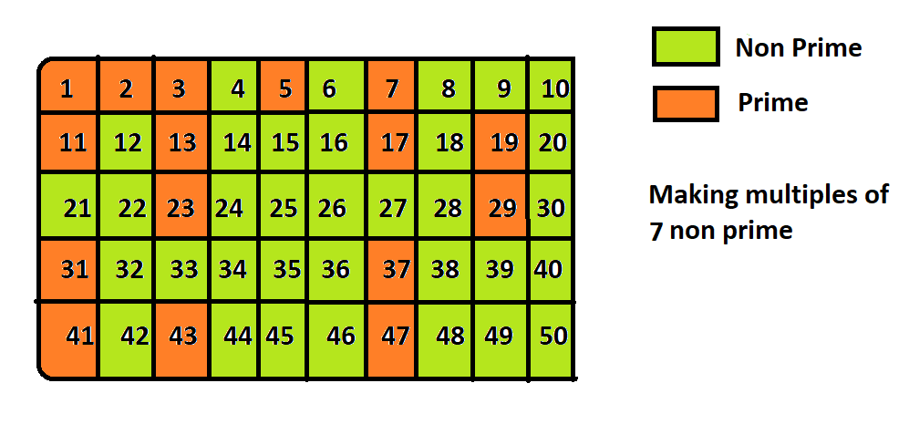
Step 3(c) - lastlly do it for 7 <Sqrt(50)

Slide 6
Step 4 ..Done :)
All numbers present inside orange box are prime....
Now Its time to code...\<>/

Slide 7
void sieve(int input)
{
int prime[n]={0};
cout<<"Prime2="<<prime[2]<<endl;
for (int i=2; i*i<=input; i++)
{
if (prime[i]==0)
{
for (int j=i*i; j<=input; j+=i)
{
prime[j]=1;
}
}
}
for (int i=2; i<input; i++)
{
if (prime[i]==0)
cout<<i<<endl;
}
20.}
//Only Function

